Slide 1
Project Presentation On “Fake News Prediction” Presented By: Ajit Madame

Slide 2
Agenda
Problem Statement
Problem Understanding
Exploratory Data Analysis
Data Preprocessing Steps
Model Building
Interpretation of the Results
Key Finding and Conclusions
Limitation of this works and Scope for Future Works

Slide 3
Problem Statements
Fake news has become one of the biggest problems of our age. It has serious impact on our online as well as offline discourse. One can even go as far as saying that, to date, fake news poses a clear and present danger to western democracy and stability of the society.
What's inside is more than just rows and columns. Make it easy for others to get started by describing how you acquired the data and what time period it represents, too.

Slide 4
Problem Understanding
Fake news's simple meaning is to incorporate information that leads people to the wrong path. Nowadays fake news spreading like water and people share this information without verifying it. This is often done to further or impose certain ideas and is often achieved with political agendas.
For media outlets, the ability to attract viewers to their websites is necessary to generate online advertising revenue. So, it is necessary to detect fake news.

Slide 5
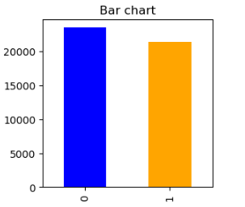
Exploratory Data Analysis Univariate Analysis: Observation: We can see, in fake news and true news in which have a less difference. Data imbalanced so we need balance it but difference is less so it will not impact that much so I take as it is.

Slide 6
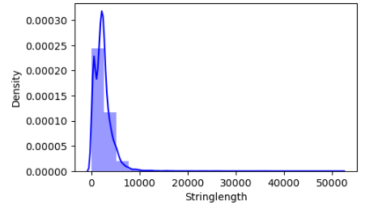
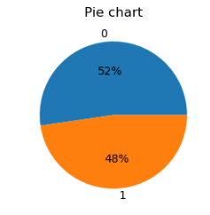
Observation: # we can see most of the news are lies between 0 to 10000 words. # We can see, in fake news and true news are having only 4% difference.

Slide 7
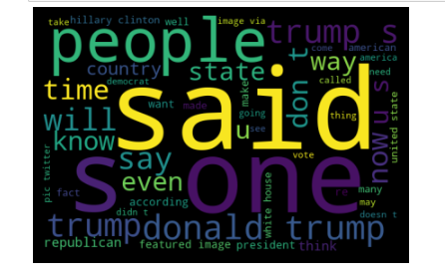
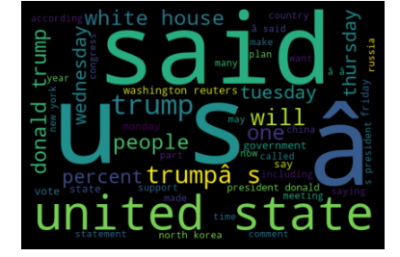
Words Claud: Observation: # People, time, said, one and trump these are the word are mostly used class 0 (fake news). # Said, USA, percent and Trump these are the words are in True news. But few words are also in fake news.

Slide 8
Data Preprocessing Steps
First step I have imported required libraries and I have imported the dataset which was in csv format.
Then I did all the statistical analysis like checking shape, nunique, value counts, info etc.
Apply Stemming using SnowballStemmer.
Here I convert text data into vector form by using TfidfVectorizer.
Then doing some EDA and Building Models.

Slide 9
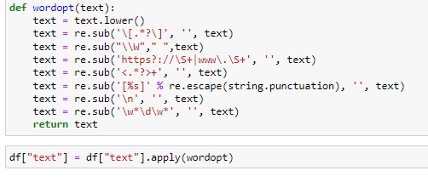
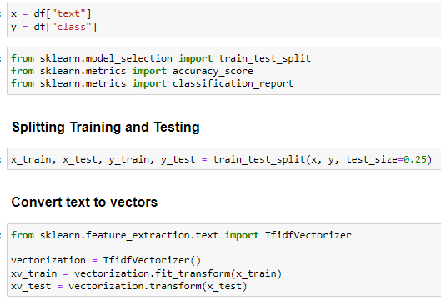
Model Building

Slide 10
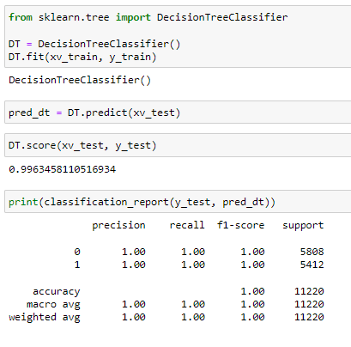
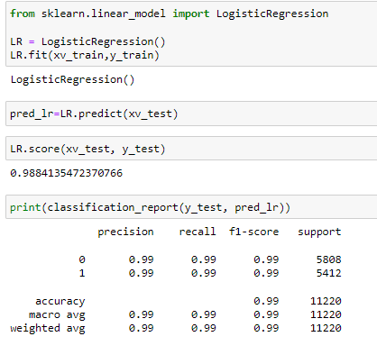
Logistic Regression Decision Tree Classifier

Slide 11
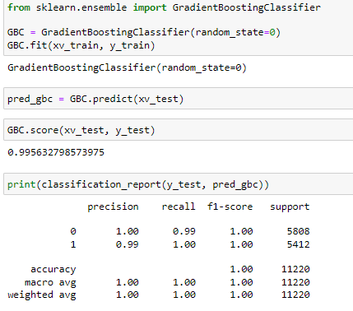
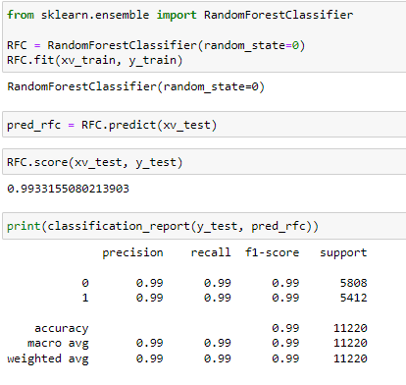
Gradient Boosting Classifier Random Forest Classifier

Slide 12
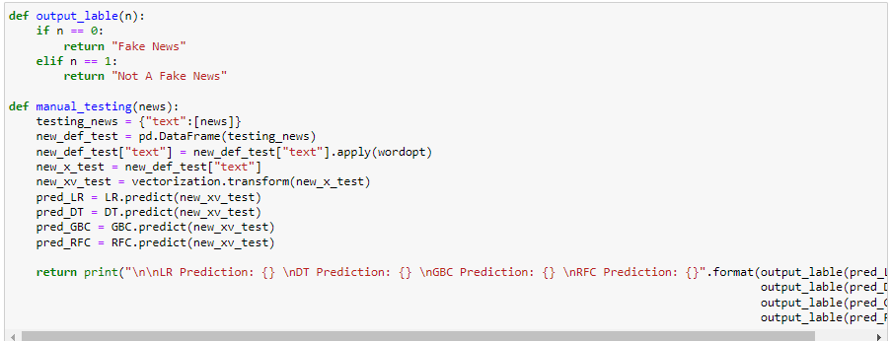
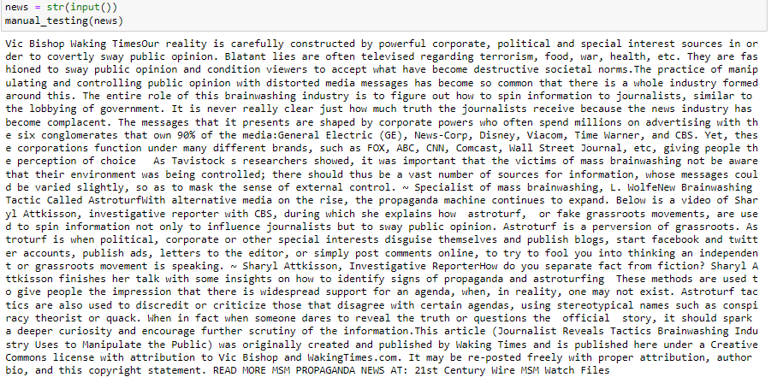

Model Evaluation

Slide 13
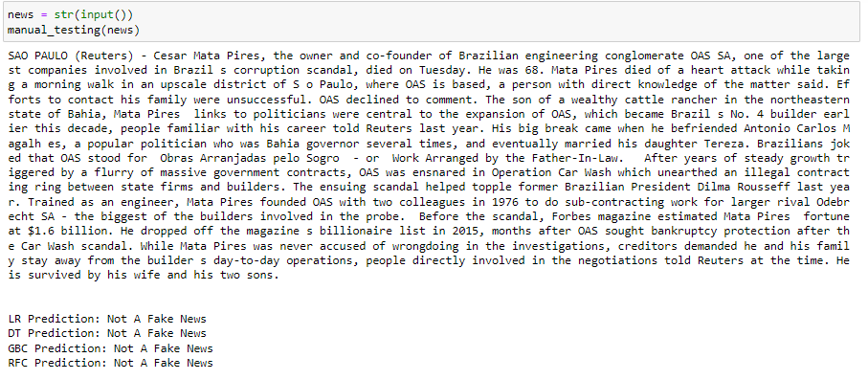

Slide 14
Key Finding and Conclusions
The finding of the study is that only few users over online use unparliamentary language. And most of these sentences have more stop words and are being quite long. As discussed before few motivated disrespectful crowds use these foul languages in the online forum to bully the people around and to stop them from doing these things that they are not supposed to do. Our study helps the online forums and social media to induce a ban to profanity or usage of profanity over these forums.
Due to fake news Distrust in the media, Undermining the democratic process, Platforms for harmful conspiracy theories and hate speech

Slide 15
Limitation of this work and scope for future
Problems faced while working in this project:
More computational power was required as it took more than 2 hours
Dataset quite balanced but too large texts
Good parameters could not be obtained using hyperparameter tuning as time was consumed more, Areas of improvement:
Could be provided with a good dataset which does not take more time.
Less time complexity

